Slide 1
Animals are Characters, too:
Fourth Grade
Unit 3
Characters Who Gallop, Bark, and Squeak
How do we portray animals in writing?
Old Wire Road Elementary School
Trisha Grayson
Deborah Goff

Slide 2
Day 1 - Goal:
I can describe in depth a character, setting, or event in a story or drama, drawing on specific details in the text.
Rate yourself: 1 – 2 – 3 – 4
Notes:
In the following video clips, animals are the main characters in the story.
Personification: Giving an animal or thing human characteristics.

Slide 3

Consider this question as you watch the video (text):
1. How has the author (film maker) portrayed the main characters?
Notes:
Discuss the way the animals are portrayed in this film clip. Talk about personification in the video. What events in the video give you clues as to how the animals are portrayed or what characteristics they possess.

Slide 4
Consider this question as you watch the video (text):
1. How has the author (film maker) portrayed the main characters?
Notes:
Discuss the way animals are portrayed in this clip. What events in the video give you clues as to what characteristics the animals in this clip possess?

Slide 5
Day 1 - Goal:
I can describe in depth a character, setting, or event in a story or drama, drawing on specific details in the text.
Now, rate yourself again: 1 – 2 – 3 – 4
Notes:
Rate yourself after the task.

Slide 6
Day 2
Goal:
I can find similarities and differences in the way animals are portrayed in fiction and non-fiction.
Rate yourself: 1 – 2 – 3 - 4
Notes:
SL.4.1 Engage effectively in a range of collaborative discussions with diverse partners on grade 4 topics and texts, building on others ideas and expressing their own clearly.

Slide 7
Essential Question:
How do we portray animals in writing?
Notes:
Talk about the Essential Question. What did we notice yesterday? We will be comparing two different texts (video and book) to understand how animals are portrayed in both fiction and non-fiction.

Slide 8
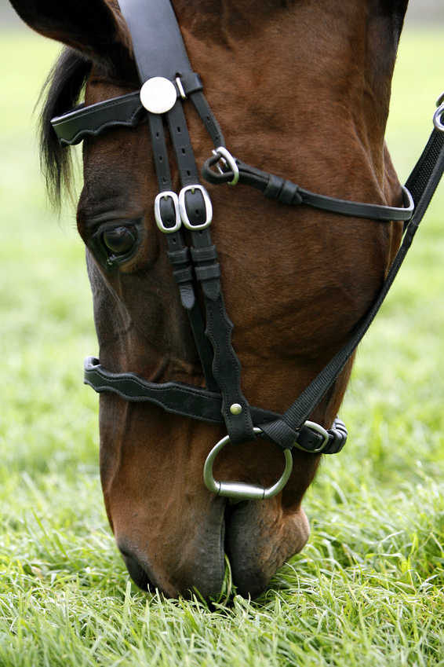
Mr. Ed
Notes:
View this clip from many years ago, in which the main character is a horse named Mr. Ed. Fiction or non-fiction?

Slide 9
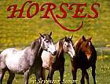
Horses by Seymour Simon
Notes:
Read selections from Horses by Seymour Simon. Fiction or non-fiction?

Slide 10
In your Interactive Student Notebook (ISN) make a T-chart.
Compare how the animals in the texts (video and book) were portrayed:
  How were the texts the same?
  How were the texts different?

Slide 11
Day 2
Goal:
I can find similarities and differences in the way animals are portrayed in fiction and non-fiction.
Now, rate yourself again:
1 – 2 – 3 - 4
Notes:
SL.4.1 Engage effectively in a range of collaborative discussions with diverse partners on grade 4 topics and texts, building on others ideas and expressing their own clearly.

Slide 12
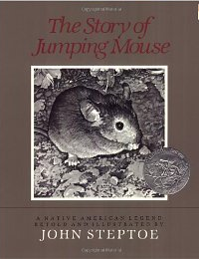
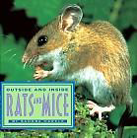
Day 3 & 4:
Goal: I can find the similarities and differences in the way animals are portrayed in fiction and non-fiction.
Rat
Rate yourself:
1 – 2 – 3 - 4
Notes:
Activate prior knowledge by watching a short clip Ratatouille. Ask “what are the characteristics of a rat?” Make a list of rat characteristics (found on the next slide) Read The Story of Jumping Mouse and make a list of the mouse characteristics. Ask students to turn and talk about how the rat and mice are portrayed. The next day review the list that you made and follow-up by reading the informational text Outside and Inside Rats & Mice. While you are reading the book students can complete the Venn Diagram on the next slide. Students can place in their interactive student notebook.

Slide 13
Characteristics of a rat:
Characteristics of a mouse

Slide 14
Compare Mice and Rats
Mice
Rats

Slide 15
Day 3 & 4:
Goal: I can find the similarities and differences in the way animals are portrayed in fiction and non-fiction.
Rat
Now, rate yourself again:
1 – 2 – 3 - 4
Notes:
Activate prior knowledge by watching a short clip Ratatouille. Ask “what are the characteristics of a rat?” Make a list of rat characteristics (found on the next slide) Read The Story of Jumping Mouse and make a list of the mouse characteristics. Ask students to turn and talk about how the rat and mice are portrayed. The next day review the list that you made and follow-up by reading the informational text Outside and Inside Rats & Mice. While you are reading the book students can complete the Venn Diagram on the next slide. Students can place in their interactive student notebook.

Slide 16

Day 5
Goal: I can explain major differences between poems, drama, and prose, and refer to the structural elements of poems and drama when writing or speaking about a text.
What is a Limerick?
Can you explain what it is?
Rate yourself:
1 – 2 – 3 - 4
Notes:
Today’s goal is a big one, our focus will be on poetry. Ask students if they know what a limerick is, chances are they will not know. Read several of the limericks from the book The Complete Nonsense of Edward Lear. When finished have the students “buzz” about what they think a limerick is from the examples that were just read. Can they come up with a definition?

Slide 17
There was a ridiculous Rat
Who was awfully puffy and fat.
“I’ll carry,” he said,
“This plate on my head,
‘Twill answer in place of a hat.”
And then he remarked with a frown,
“I suppose that I must have a gown;
I’ll make me a kilt
Of this old crazy-quilt,
To wear when I’m going to town.
“And of course, though the weather is warm,
It may be there’ll come up a storm;
An umbrella I’ll make
Of a caraway cake,
It’ll match with my whole uniform.
"And I’ll carry a bottle of ink
In case I should wish for a drink;
And this flat-iron so sweet
I’ll take with me to eat,
And now I am ready, I think.”
The Erratic Rat
Traditional Limerick
Notes:
Pass out a poem to each child. Have them read the poem several times. Ask them why this poem is considered a limerick? Do the characteristics match the definition that they came up with? Discuss the poetry elements: verse, rhythm, and meter. If time allows have them illustrate what the Limerick means to them.

Slide 18
Day 5
Goal: I can explain major differences between poems, drama, and prose, and refer to the structural elements of poems and drama when writing or speaking about a text.
What is a Limerick?
Can you explain what it is?
Now, rate yourself again:
1 – 2 – 3 - 4
Notes:
Today’s goal is a big one, our focus will be on poetry. Ask students if they know what a limerick is, chances are they will not know. Read several of the limericks from the book The Complete Nonsense of Edward Lear. When finished have the students “buzz” about what they think a limerick is from the examples that were just read. Can they come up with a definition?

